Slide 1
ASHRAE Task Force for Building Decarbonization
HVACR, CO2 & YOU
Tennessee Valley Chapter January 2, 2022
Task Force Standards & Codes WG Chair
Terry E. Townsend, PE, Fellow ASHRAE
ASHRAE Presidential Member
NEBB BSC-CP & NEBB RCx-CP

Slide 2
Formation of the Task Force for Building Decarbonization
Formation of the Task Force for Building Decarbonization
(TFBD)
Initiative of ASHRAE President, Chuck Gulledge, and President-Elect, Mick Schwedler, in February 2021
15 Task Force Members
Nine working groups with over 100 international volunteers
Realization that our successful initiatives in building energy efficiency should be expanded to building decarbonization

Slide 3
ASHRAE Treasurer,
Notes:
International and Multi cultural with diverse backgrounds in building industry

Slide 4
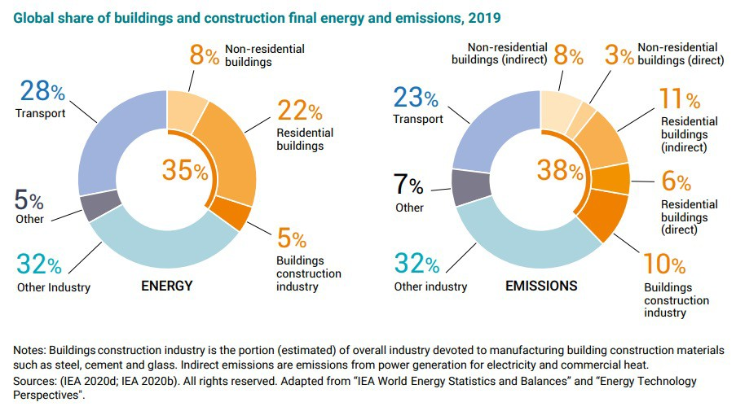
Why is ASHRAE Doing This?
Do buildings make a difference?
Notes:
DC
building sector worldwide = 38% of all energy-related CO₂ emissions
(including the building construction industry emissions)

Slide 5
Decarbonizing End Uses: DOE priorities
Do buildings make a difference?
SOURCE: Carnegie Mellon Center for Building Performance and Diagnostics (2020).

Slide 6
Building Decarbonization Issues
One-size does not fit all
Residential – commercial - industrial
New – retrofit (75% of buildings in 2050 are already built)
Spectrum of existing generation fuel mix
Developed vs underdeveloped countries
Definitions
Net zero carbon includes operational, embodied, whole life carbon, upfront carbon
Notes:
DC

Slide 7
Building Decarbonization Issues
Metrics
Focus on Energy Use or Carbon Emissions (embodied and operational)
Offsets–example–allowed in CIBSE but not ASHRAE 228P
Benchmarks – common measurement scale
Inclusion of plug loads or just thermal
Embodied carbon / LCA – availability of data and geographically differences
Notes:
TP

Slide 8
Why is Carbon important to ASHRAE?
Direct building CO₂ emissions need to be cut in half by 2030 to achieve net zero carbon building stock by 2050
Of those who have submitted Nationally Determined Contributions (NDCs), 136 countries mention buildings, 53 countries mention building energy efficiency, and only 38 specifically call out building energy codes.
ASHRAE has an international presence – Members in over 130 countries
ASHRAE is the standards authority for energy usage and efficiency in buildings
Notes:
DC

Slide 9
What is ASHRAE TFBD Going to be Doing?
Objectives of Task Force for Building Decarbonization
Find and engage individuals/groups/organizations with pertinent skills/knowledge/expertise
Provide information to policy makers on how they might achieve the established goals
Provide recommendations and practices to industry stakeholders
Identify existing portfolio of technical resources
Package these technical resources in a useful way
Provide tools on energy efficiency, embodied carbon, and reducing operational carbon
Identify knowledge gaps and develop resources to address those gaps
Notes:
Three points: Engage in conversation. Provide information, Develop recommendations

Slide 10
How is the Task Force Going to Accomplish This?
How is the Task Force going to accomplish this?
Issue a Public Policy Issues Brief (PPIB)
Establish Position Document Committee and nine Working Groups
Each autonomous WG will address an identified key areas of concern
Each WG will deliver recommendations and practices for industry stakeholders
A website to disseminate the information
Future Conferences, Standards & Codes, Webinars
Notes:
TP

Slide 11
The Process
What’s Happening Now?
Task Force
Twice monthly meetings began in March 2021
Working Groups
Bi-weekly meetings began in late April 2021
Relevant ASHRAE Technical Committees are providing input
Web site – soft launch www.ashrae.org/decarb
Notes:
TP

Slide 12
How is the Task Force (TFBD) organized?
ASHRAE ExCom
TFBD
Working Groups
Liaisons
Knowledge Hub
Sequestration on Building Site
Appliance & Equipment Standards
Government Affair Committee
Position Document Technical Committee
Embodied Carbon/LCA
Operational Carbon
Grid Building Intersection
Communications
Others (TBD)
Building Performance Standards
Building Standards & Codes
Training & Education
Notes:
DC

Slide 13
What is Each Working Group Doing?
Position Document Working Group
Outline ASHRAE’s positions on:
Embodied carbon from cradle to grave
Operational carbon
Importance of decarbonization and effects on sectors of the built environment
General policy goals at local, federal and international levels
Resources available to meet building decarbonization goals
Commitments to ASHRAE action
www.ashrae.org/decarb
Notes:
DC

Slide 14
What is Each Working Group Doing?
Research / Knowledge Hub Working Group
Collaborate with other Working Groups and Affiliated Groups globally to Identify and Archive Resources Available:
Definitions
Literature
Research
Policy Goals
Notes:
TP

Slide 15
What is Each Working Group Doing?
Operational Carbon Working Group
Identify issues in migrating to less carbon intensive energy sources
Identify strategies to minimize building electrical consumption
Develop strategies to transition from an energy-based metric to a carbon-based metric
Refine the approach to metrics to recognize carbon mitigation strategies that reduce overall emissions
Notes:
TP

Slide 16
What is Each Working Group Doing?
Embodied Carbon / Life Cycle Assessment Working Group
Provide guidance on how to measure carbon in materials, products, services, and processes from cradle to grave
Develop a framework and roadmap for LCA and embodied carbon including Guidelines, Reference Portals, Training and Education, Special Publications, Benchmarking Metrics, etc,
Determine a holistic methodology to quantify how materials, products, services, and processes from cradle to grave affect climate change, non-renewable resources and the environment
Notes:
TP

Slide 17
Building Standards and Codes Working Group
Identify current standards and codes related to decarbonization of buildings
Determine what technical guidance and resources are needed to make standards and codes more comprehensive and usable
Determine the applicability of prescriptive- and performance- based standards in evaluating low/no-carbon alternatives
Evaluate ways to reconfigure monitoring and compliance standards to satisfy decarbonization-based requirements of governmental policy makers
Notes:
DC

Slide 18
What is Each Working Group Doing?
Appliance and Equipment Standards Working Group
Review the various methods being used globally to quantify the total carbon emissions from appliance and equipment use
Report on the suitability of current equipment and system performance metrics and life cycle carbon emission calculation methods with recommendations on future work
Develop guidance for manufacturers on a practical and repeatable way to calculate lifecycle carbon emissions and embodied carbon in HVAC&R appliances and equipment
Produce a roadmap to close gaps identified in existing calculation methods
Work with industry and government to identify an acceptable and practical method for providing total carbon impacts for mechanical systems
Produce a product and service portfolio of standards, tools and guidelines to ensure an unbiased approach
Notes:
DC

Slide 19
What is Each Working Group Doing?
Carbon Sequestration on Building Sites Working Group
Identify non-industrial, non-commercial carbon sequestration methods and technologies that are site scalable
Develop the data, information, programs and tools necessary to assess the relevancy and applicability of these technologies in reducing carbon emissions at the site level
Notes:
TP

Slide 20
Training and Education Working Group
Identify current and propose new training, education, and publications that will support the learning of decarbonization of the built environment
Create an inventory of ASHRAE’s and other organizations’ resources that address decarbonization of the built environment
Determine the training and education needs of the various different type of stakeholders and recommend the development of resources to meet these needs
Notes:
TP

Slide 21
What is Each Working Group Doing?
Building Performance Standards Working Group
Areas to Address
Identify different ways of measuring and reporting building performance
Define metrics to measure the energy and carbon targets and goals for carbon reduction
Identify limits of general building stock and individual building metrics
Show the integral role of commissioning and retro-commissioning as a part of the building metrics
Identify best practices of policy, tools and resources for the implementation of building performance metrics
Deliverables
One-page debrief to policy maker laying out current best practices of policy on BPS
Framework document to outline all identified key issues to address
BPS guideline and online portal with resource and best practices to all key issues.
Notes:
DC

Slide 22
What is Each Working Group Doing?
Grid-Building Intersection Working Group
Provide guidance on:
Use of secure building-grid communication systems to enable integration of low-carbon distributed energy resources
Identify value to buildings and to the grid of resilience, load flexibility, controls, information systems, and energy storage systems (electrical and thermal) that are cost effective and responsive
Identify optimized responses of buildings to signals from the grid
Deliverables:
White paper focused on needs assessment
What do we have and what needs to be developed
Issues/Policy paper on roadblocks and opportunities
Notes:
DC

Slide 23
2022 ASHRAE WINTER MEETING HAPPENINGS
ASHRAE BOARD OF DIRECTORS ACTIONS
UNANIMOUS APPROVAL
“ASHRAE POLICY WILL ADDRESS DECARBONIZATION OF THE GLOBAL BUILT ENVIRONMENT WITH THE SAME LEVEL OF IMPORTANCE AND URGENCY AS ASHRAE TACKLED ENERGY EFFICIENCY DURING THE ENERGY CRISIS.”
Notes:
TP

Slide 24
The Process
2022 ASHRAE WINTER MEETING HAPPENINGS
IMPLEMENTATION ACTIONS FOR BUILDING DECARBONIZATION
Immediately begin developing operational carbon Information Appendices for 90.1 and 90.2
Develop an aligned set of carbon and decarbonization definitions for common use across ASHRAE
Commission a new Design Guide Series around decarbonization of existing buildings
Notes:
TP

Slide 25
The Process
2022 ASHRAE WINTER MEETING HAPPENINGS
IMPLEMENTATION ACTIONS FOR BUILDING DECARBONIZATION
Commission development of a new Global Whole Life Carbon and Embodied Carbon Framework and Standard
ASHRAE “message” to emphasize decarbonization as equally (or more) important as energy efficiency
Ensure appropriate collaboration with other organizations globally
Notes:
TP

Slide 26
The Process
2022 ASHRAE WINTER MEETING HAPPENINGS
ICC ACTIONS FOR BUILDING DECARBONIZATION
PINS filed with ANSI on 01-28-22:
“Measurement and Verification of Carbon in Building Construction, Materials and Operations”
Notes:
TP

Slide 27
The Process
TEST---Methods of Assessment
U.S. Grid is undergoing a transformation to decarbonize & improve resiliency of delivered power (T or F)
Smart Buildings can directly interact with grid operators application program interfaces (APIs) to help balance grid loads (T or F)
There is only one way to integrate an automated demand response interface with smart building’s controls (T or F)
The U.S. power grid can benefit from interactions with buildings to lower costs and improve service (T or F)
The Gridwise Architecture Council was created by DOD (T or F)
Notes:
TP

Slide 28
The Process
Future Happenings Standards & Codes WG
Subscription Service for Government Officials and Policy Makers – Non-technical summaries developed by Standards Committees and Technical Committees/Task Groups of new ASHRAE Standards, Design Guides, technical publications, etc… Provide options for sought summaries to subscribers and the languages these summaries would be provided in. (Priority #1a - cost estimate = $100,000 and timeline for initial product = 9 months)
Carbon Tools for Code Officials – Residential and Commercial Buildings (initially) (Priority #1b – global participation cost estimate = $350,000 and initial products timeline of 18 months)
Optimization of Embodied versus Operational Carbon (Priority #1c - $250,000 for global participation, estimated minimum of 6 face-to-face meetings & timeline of 18 months)
Develop a Carbon Audit Guidebook (Priority #2 – cost estimate = $150,000 for global participation and completion timeline of 12 months)
Provide a means for continuous feed-back from GAC (and its RVCs) on the changing needs of the global communities’ policy makers, code officials and the ASHRAE members who are striving to meet the carbon-reduction challenges they are underàare ASHRAE’s products what is needed or what modifications, additions or new products are needed? (Priority #3 – cost estimate (staff time primarily; possible use of external resource at $50,000/year and timeline for implementation = 6 months)
Notes:
TP

Slide 29
The Process
Future Happenings
Coming in June 2022!!
ASHRAE Summer Meeting Toronto Canada with multiple Seminars and Technical Sessions on Building Decarbonization
Coming in October 2022!!
ASHRAE International Conference on
Building Decarbonization
Athens, Greece
Hosted by the Hellenic Chapter &
the ASHRAE Task Force for Building Decarbonization
Notes:
TP

Slide 30
Questions?

